Slide 1
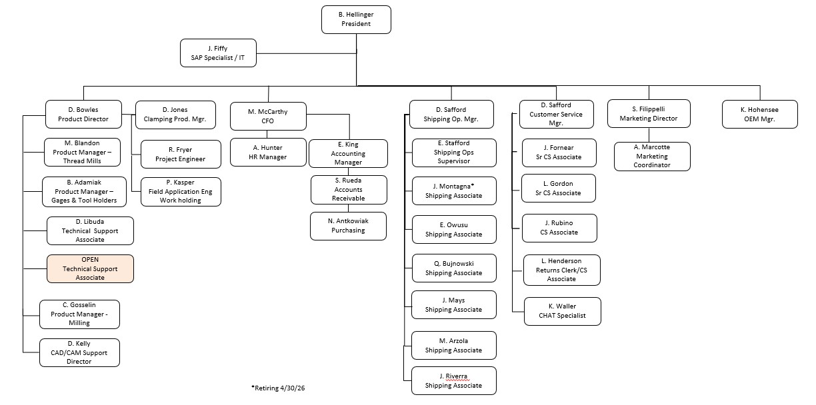
Organizational Chart – Corporate Structure

Slide 2
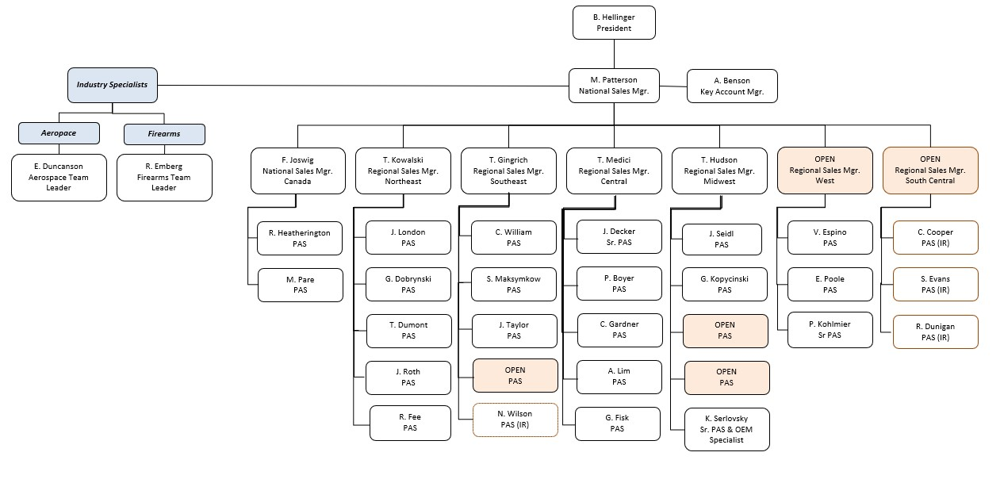
Organization Chart - Sales

Slide 3
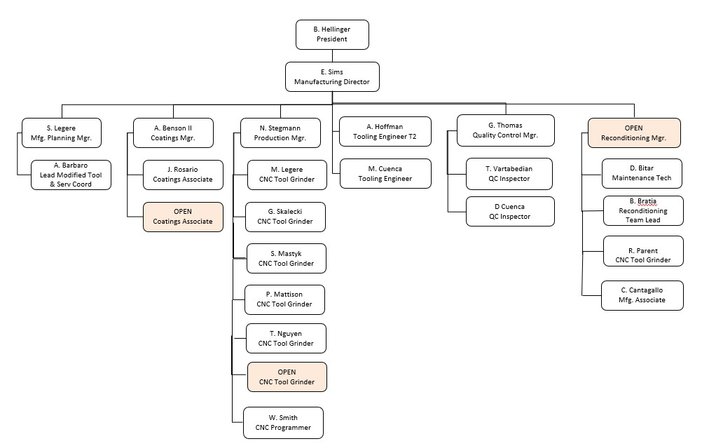
Organizational Chart - Manufacturing

Slide 4
Employee Benefits – Contact Information
Mass General Brigham: 866-414-5533 / www.massgeneralbrighamhealthplan.org
Group Name: Emuge Corporation Plan ID: HMO – QZAMG / PPO - QZAPPO
MGBH_PPO_New_Enroll_Kit
Altus Dental: 877-223-0588 / www.altusdental.com
Group Name: Emuge Corportation Group Number: 4899-0001
Altus Dental Benefits Summary 2026.pdf
Altus_PreventiveRewards-Flyer 2026.pdf
VSP Vision Care: 800-877-7195 / www.vsp.com
No ID cards issued, use name and social security number
VSP Coverage Pamphlet 2026.pdf

Slide 5
Employee Benefits – Contact Info
Equitable Insurance (Disability/Accident/Life) : 866-274-9887
www.equitable.com/employeebenefits
Group Name: Emuge Corporation Policy Number: 025688 - Disability/Accident/Life 025689 – MA PFML
Equitable Life-STD-LTD-Accident Benefit Info.pdf
MSM Wealth Management: 401K account or investment consulting services
Aaron Murphy – aaron@msmwmg.com / 800-539-8517

Slide 6
Employee Health Benefit Programs

Slide 7
Employee Health Benefit Programs

Slide 8
Employee Benefits – EAP Program

Slide 9
Employee Benefits – Travel Assistance

Slide 10
Employee Benefits – Helpful Contact Information
If you have a specific issue that Member Services cannot help you with the contacts below are available to assist you.
Innovo Benefits
Cory Harris – charris@innovobenefits.com; 978-775-5419
Eric Gulko – egulko@innovbenefits.com; 978-213-8481
Please contact them only after you’ve tried to get help through member services at MGBH, Altus, VSP, or Equitable.
For any payroll or Paylocity issues or questions, please contact Mike McCarthy.

